Slide 1
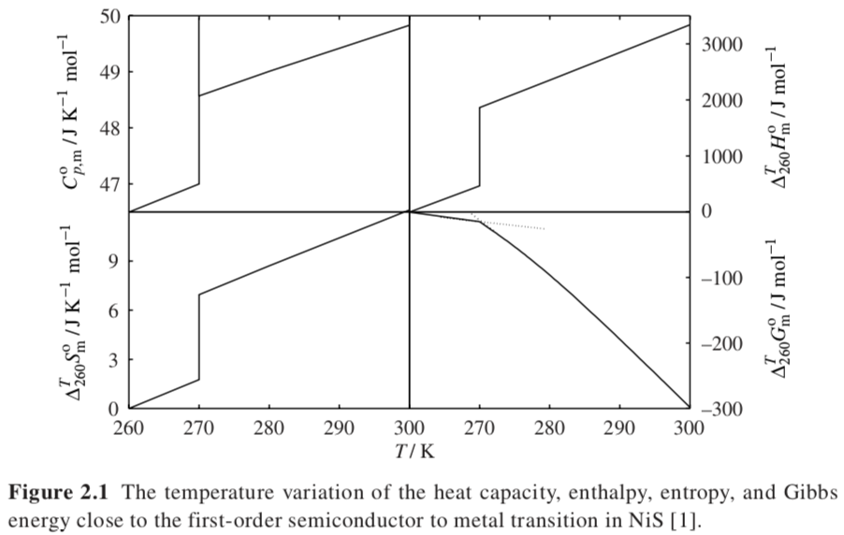
Single Component Systems
First Order Transition
Gibbs Free Energy is the same for water and ice at 0°C. Slope is different, ΔS.
There is an enthalpy of fusion ΔH_{f} and an entropy change on melting ΔS_{f}.
These balance ΔG = ΔH –TΔS = 0.
C_{p} = (∂H/∂T)_{p} There is a change in the slope of the H vs. T plot at the melting point. Ice holds less heat than water.
ΔG_{f} = 0 = ΔH_{f} – T_{f}ΔS_{f}
T_{f} = ΔH_{f}/ΔS_{f}
Mott Transition
https://en.wikipedia.org/wiki/Mott_transition

Slide 2
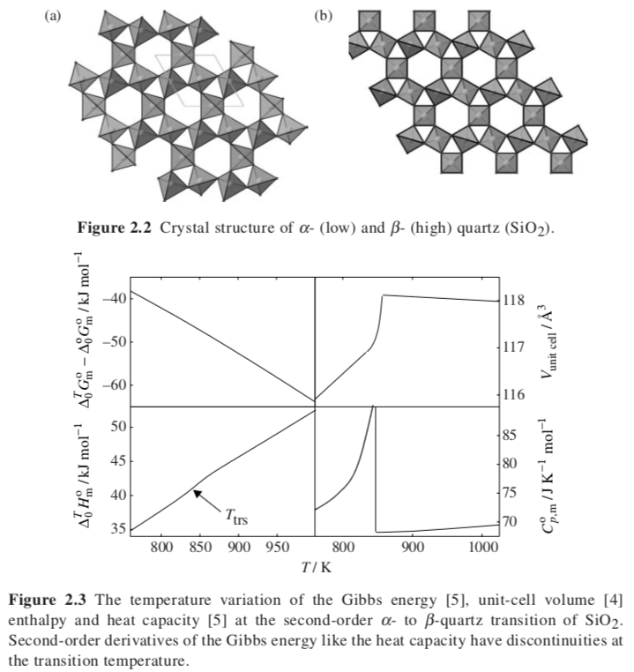
Second Order Transition

Slide 3
Clausius-Clapeyron Equation
(what is the dependence of vapor pressure on temperature?)
Consider two phases at equilibrium, α and β
-S U V
H A
-p G T
dμ_{α} = dμ_{β}
dG = Vdp –SdT
dμ_{α} = dμ_{β}
So,
V^{α}dp – S^{α}dT = V^{β}dp – S^{β}dT
So,
dp/dT = ΔS/ΔV
and
ΔG = 0 = ΔH – T_{trans}ΔS so ΔS = ΔH/T_{trans}
and
dp/dT = ΔH/(T_{trans}ΔV) Clapeyron Equation
For transition to a gas phase, ΔV ~ V^{gas}
and for low density gas (ideal) V = RT/p
d(lnp_{vap})/dT = ΔH_{vap}/(RT_{vap}²) Clausius-Clapeyron Equation
This allows calculation of the vapor pressure as a function of T

Slide 4

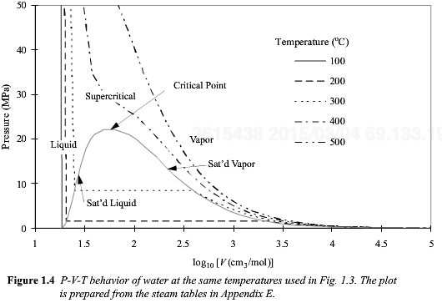
Clausius Clapeyron Equation
d(ln p^{Sat})/dT = ΔH_{vap}/(RT_{vap}²) Clausius-Clapeyron Equation
d(ln p^{Sat}) = (-ΔH_{vap}/R) d(1/T)
ln[p^{Sat}/ p_{C}^{Sat}] = (-ΔH_{vap}/R) [1/T – 1/T_{C}] Use the critical point as the reference state
Shortcut Vapor Pressure Calculation:
From the “Chemical Engineering Book” Elliot and Lira

Slide 5
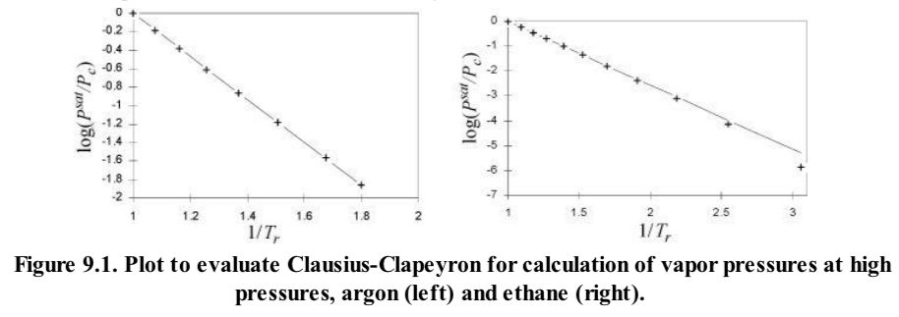
Clausius Clapeyron Equation
d(ln p^{Sat}) = (-ΔH_{vap}/R) d(1/T)
ln[p^{Sat}/ p_{R}^{Sat}] = (-ΔH_{vap}/R) [1/T – 1/T_{R}]
This is a kind of Arrhenius Plot

Slide 6
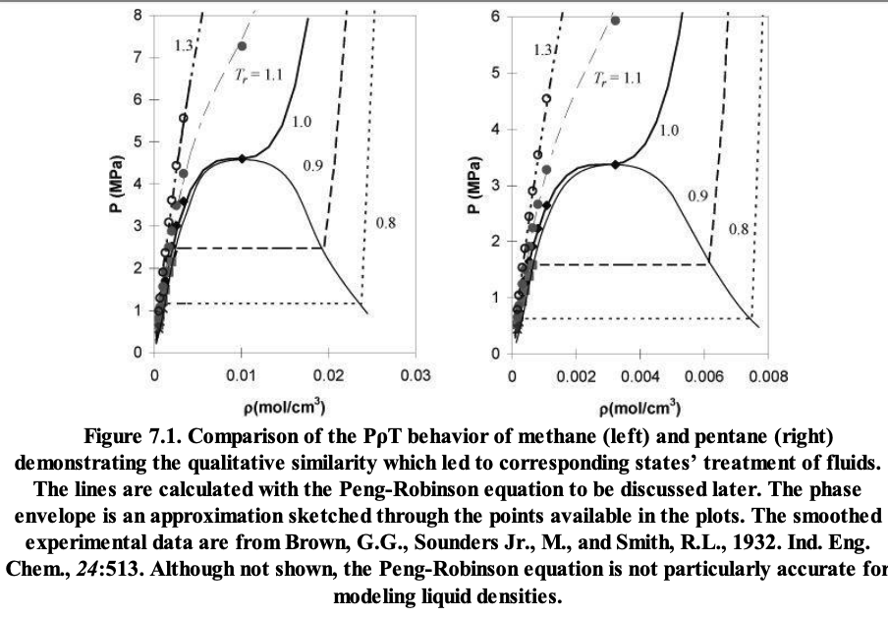
Clausius Clapeyron Equation

Slide 7

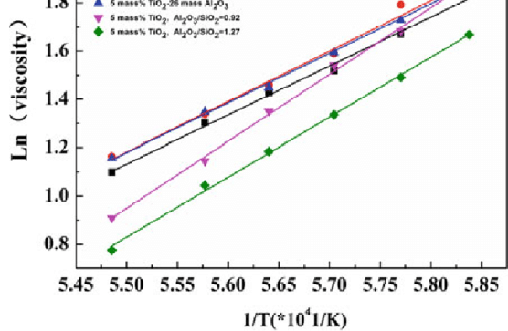

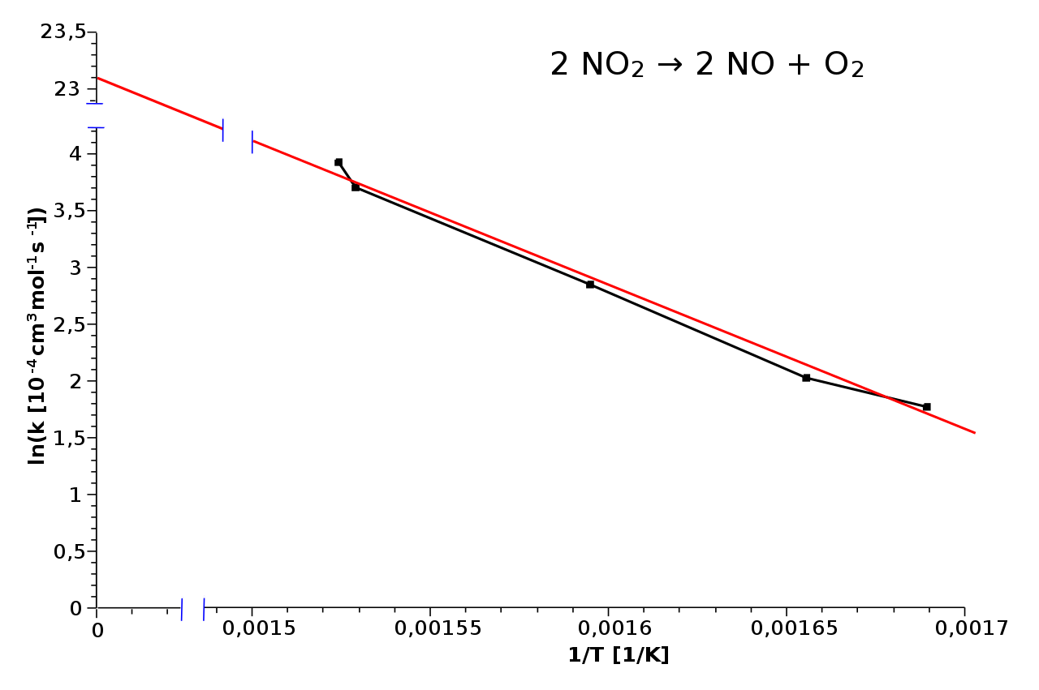
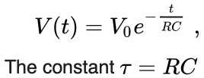
“A” Not dependent on T for Arrhenius
A ~ kT/h for Eyring
This is a kind of Arrhenius Plot
Eyring Rate Theory
Both Eyring and Arrhenius are “rate” laws not equilibrium laws
d(ln p^{Sat}) = (-ΔH_{vap}/R) d(1/T)
ln[p^{Sat}/ p_{R}^{Sat}] = (-ΔH_{vap}/R) [1/T – 1/T_{R}]

Slide 8
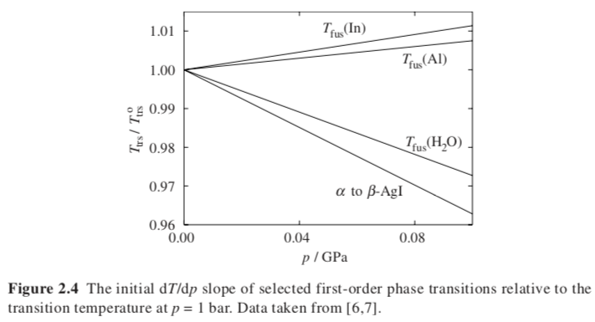
Clapeyron Equation predicts linear T vs p for transition
dp/dT = ΔH/(TΔV)
Clapeyron Equation

Slide 9
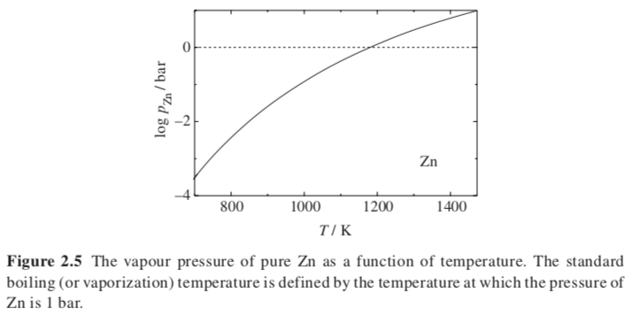

Clausius-Clapeyron Equation

Slide 10
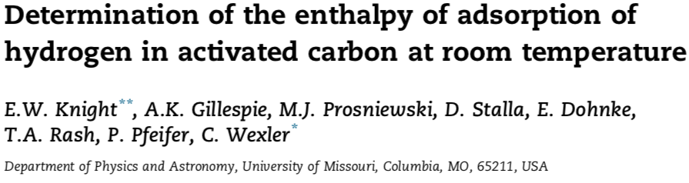

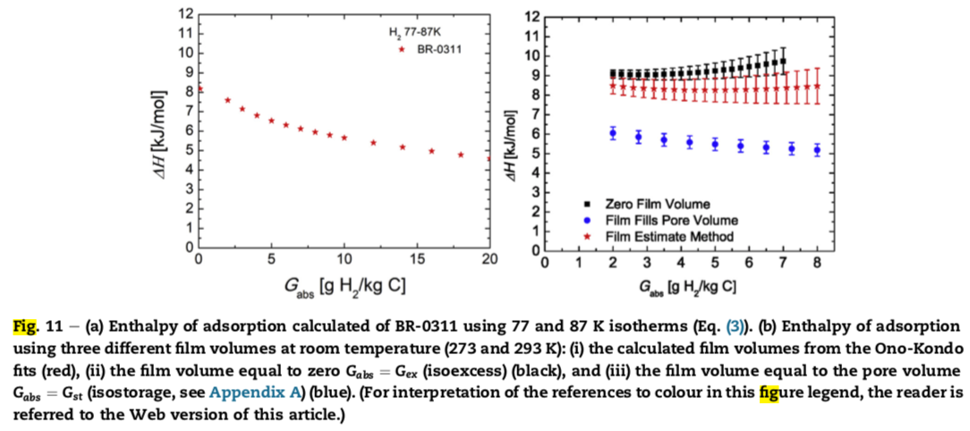
Consider absorption of a gas on a surface
First order transition from a vapor to an absorbed layer
Find the equilibrium pressure and temperature for a monolayer of absorbed hydrogen on a mesoporous carbon storage material
ln[p^{Sat}/ p_{R}^{Sat}] = (-ΔH_{vap}/R) [1/T – 1/T_{R}]
Use Clausius–Clapeyron Equation to determine the enthalpy of absorption
G = g H₂ Absorbed per kg C

Slide 11
Van’t Hoff Equation (Looks like Clausius Clapyron Equation)
For a chemical reaction the equilibrium constant Keq = product(x_{products})/product(x_{reactants})
ΔG = -RTlnK_{eq} = ΔH – TΔS
lnK_{eq} = -ΔH/RT + ΔS/R
d(lnK_{eq})/dT = +ΔH_{rxn}/RT² Van’t Hoff Equation
(Henry’s law constant is treated as an equilibrium reaction constant)
For mixtures
Dilute: Henry’s Law Partial Pressure, p_{i} = H_{ij} x_{i}, H_{ij} follows d(lnH_{ij})/dT = ΔH_{ij}/RT²
Ideal: Raoult’s Law Partial Pressure, p_{i} = p_{sat} x_{i}
d(ln p^{Sat})/dT = ΔH_{vap}/(RT_{vap}²) Clausius-Clapeyron Equation

Slide 12
Second Order Transition

Slide 13
α = (1/V) (∂V/∂T)_{p}
κ_{T} = (1/V) (∂V/∂P)_{T}
What About a Second Order Transition?
For Example: Glass Transition T_{g} versus P?
There is only one “phase” present. A flowing phase and a “locked-in” phase for T_{g}.
There is no discontinuity in H, S, V
dV = 0 = (∂V/∂T)_{p} dT + (∂V/∂p)_{T} dp = VαdT – Vκ_{T}dp
dp/dT_{g} = Δα/Δκ_{T}
T_{g} should be linear in pressure.

Slide 14
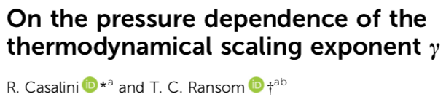
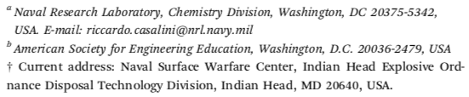
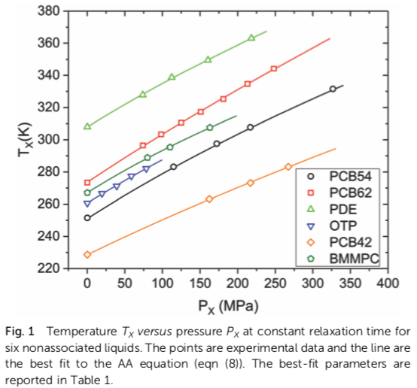
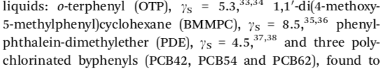
dp/dT_{g} = Δα/Δκ_{T}
Soft Matter, 2020, 16, 4625
x is the dielectric relaxation time
Glass transition depends on the rate of observation, so you need to fix a rate of observation to determine the transition temperature.

Slide 15
The glass transition occurs when the free volume reaches a fixed percent of the total volume according to the iso-free volume theory. This figure shows this value to be 11.3%. The bottom dashes line is the occupied volume of molecules, which increases with temperature due to vibration of atoms. The right solid line is the liquid line which decreases with decreasing temperature due to reduced translational and rotational motion (free volume) as well as molecular vibrations (occupied volume). At about 10% the translational and rotational motion is locked out and the material becomes a glass. The free volume associated with these motions is locked in at T_{g}.
From L. H. Sperling, "Introduction to Physical Polymer Science, 2'nd Ed."

Slide 16
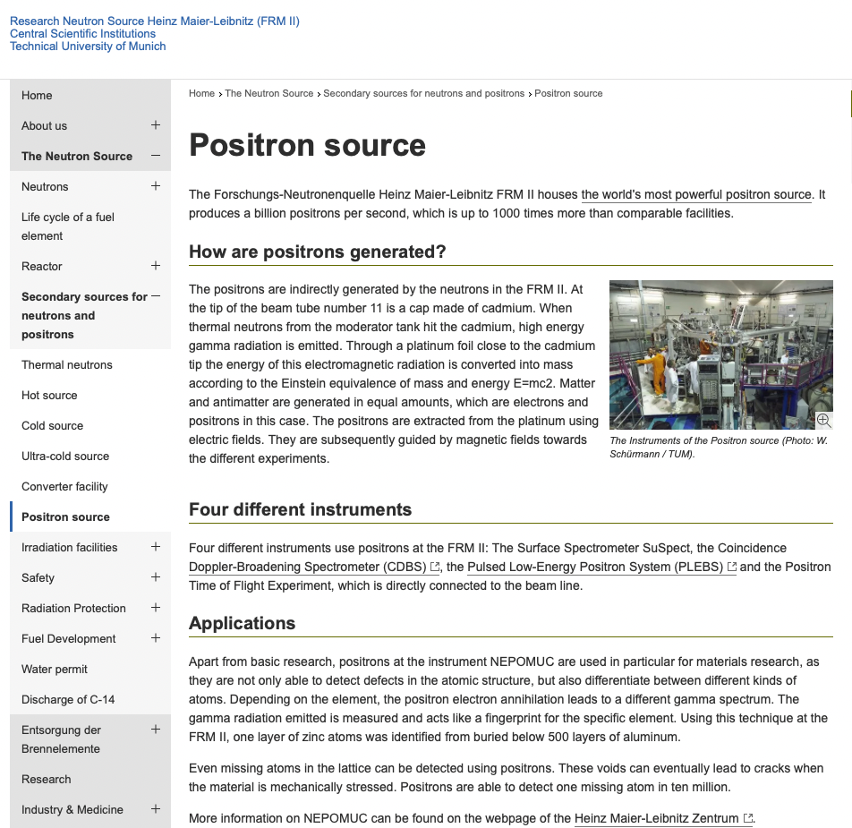
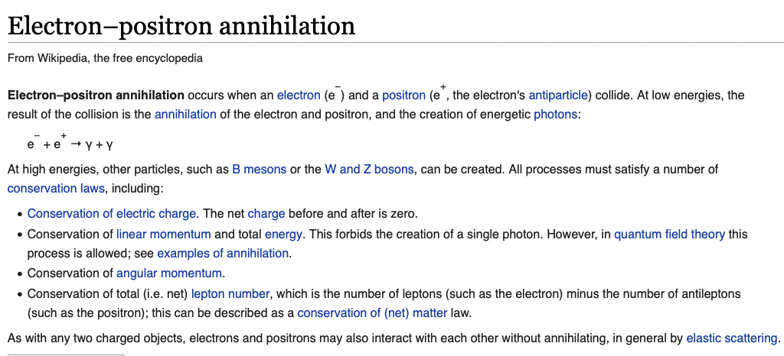
https://www.frm2.tum.de/en/frm2/secondary-sources/positron-source/
https://en.wikipedia.org/wiki/Electron–positron_annihilation
From L. H. Sperling, "Introduction to Physical Polymer Science, 2'nd Ed."

Slide 17


Number of end-groups = 2/M_{n}
Flory-Fox Equation
End groups have more free volume
T_{g} occurs when the free volume reaches less than V_{free} ≤ 0.113V
Fox Equation
This indicates that the parameter of interest is 1/T_{g}
T_{g} is the temperature where a certain free volume is found due to thermal expansion, V = V_{occupied} + V_{free} = V₀ + Vα_{T}dT
T_{g} is the temperature where V_{free}/V = 0.113

Slide 18
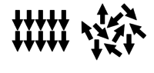
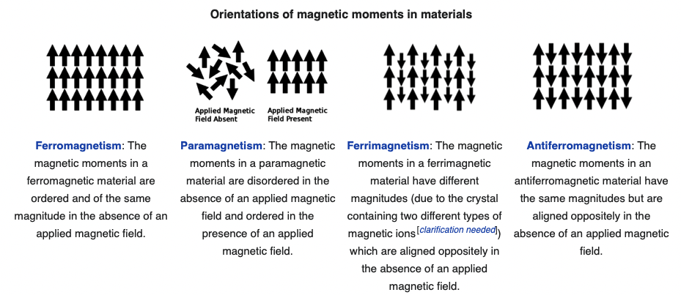
Some other second order transitions:
Curie Temperature (permanent magnetism disappears Ferro to Para magnetic)
Neel Temperature (antiferromagnetic becomes paramagnetic)
Ferro to Para Magnetic (Curie Temp)
Ferri to Para Magnetic (Neel Temp)

Slide 19
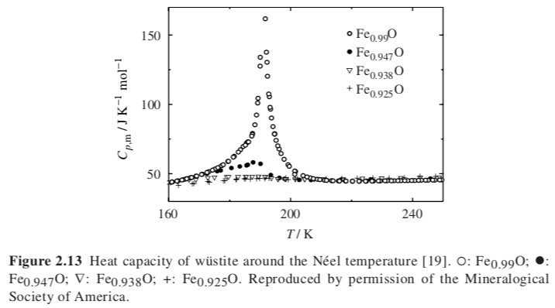
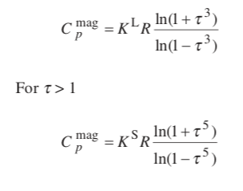
Usually Second order transition Neel Temperature (like Curie Temp for antiferromagnetic) Fe_{0.947}O
Some cases First order transition (shown here for Fe_{0.99}O)
(∂H/∂T)_{p} = C_{p}
Inden Model τ = T/T_{tr}
For τ <1

Slide 20
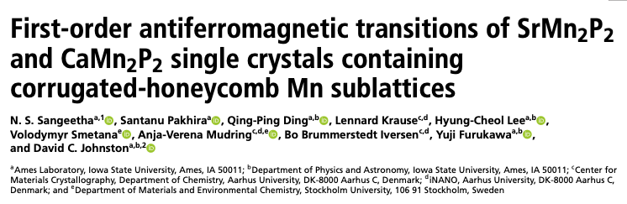
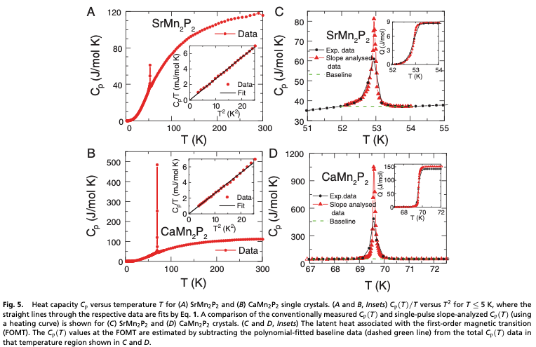

Slide 21
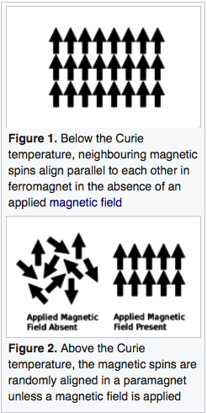
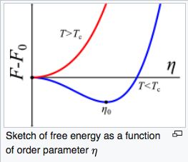



Landau theory for 2’nd order transitions based on a Taylor series expansion of the Gibbs free energy in the “Order Parameter” Γ
-The free energy is analytic (there is a function)
-The free energy is symmetric in T (only even powers of T)
The order parameter was originally the magnetization, m
For liquid crystals it is the director
For binary blends it can be the composition
Curie Temperature is the critical point for ordering. Above T_{c} no order and m = 0 in the absence of a magnetic field, i.e. paramagnetism
Below T_{c}, m has a value.
Γ
At constant T and p
Γ₀
Γ
“a” is a bias associated with the direction of magnetization, this is 0 above T_{c}
“b” is positive above T_{c} and changes sign at T_{c}

Slide 22
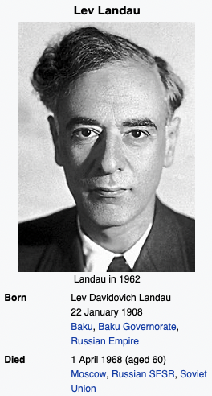
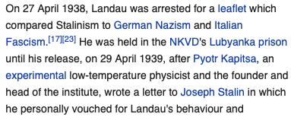
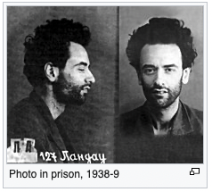

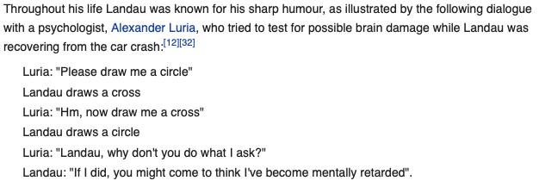

Landau theory for order parameter

Slide 23
Landau theory for 2’nd order transitions
The order parameter Γ could be concentration (normal phase separation), magnetization (magnets) , orientation (LCs)
The point is to find a value for Γ above and below the critical point T_{c} (where phase separation become possible).
Particularly above T_{c}, Γ = 0 and we have no ”order” (think of no magnetization above the Curie temperature or no deviation from the average composition (ρ - < ρ >) above the critical temperature).
-The free energy is analytic (there is a function in Γ and T)
-The free energy F is symmetric in Γ (only even powers of Γ)
For simplicity, take a two term Taylor series expansion ΔF = a(T) Γ ² + b(T)/2 Γ ⁴
Near the critical temperature assume for simplicity
ΔF = a₀ (T - T_{c}) Γ ² + b₀/2 Γ ⁴
For a solution to Γ, you must have b₀ > 0 (this is obvious below); and a(T) must change sign for phase separation to occur at T_{c} so a(T) = a₀ (T - T_{c})
At the critical point ∂F/∂Γ = 0 = 2a₀ (T - T_{c}) Γ₀ + 2b₀ Γ₀³
To minimize free energy and make a stable phase either Γ₀ = 0 (above T_{c}) or Γ₀² = - a₀ (T - T_{c})/b₀ (for T ≤ T_{c})
For T ≤ T_{c}, Γ₀ ~ (T - T_{c})^{1/2} The critical exponent is ½ for Landau theory.
Γ
Γ₀
Γ

Slide 24
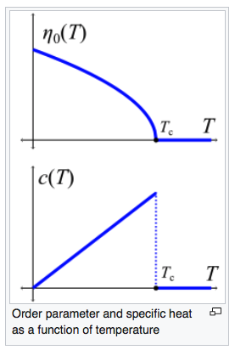
Landau theory for 2’nd order transitions
-S U V
H A
-p G T
dH = VdP + TdS
C_{p} = (∂H/∂T)_{P} = T (∂S/∂T)_{P}
G = ΔF = H – TS
(dΔF/dT) = (dH/dT) – T(dS/dT) – S
(d²ΔF/dT²) = -(dS/dT) = -C_{p}/T
C_{p} = -T (d²ΔF/dT²)
ΔF = a₀ (T - T_{c}) Γ² + b₀/2 Γ⁴
Γ₀ = 0 (above T_{c}) and Γ₀² = - a₀ (T - T_{c})/b₀ (for T ≤ T_{c})
ΔF = 0 (above T_{c}) and ΔF = -a₀² (T - T_{c})²/b₀ + a₀⁴/2 (T - T_{c})²/b₀ = -a₀² (T - T_{c})²/2b₀
C_{p} = 0 (above T_{c}) ; and C_{p} = -T (d²ΔF/dT²) = T a₀²/b₀ (for T ≤ T_{c})
Γ
Discontinuity in the second derivative of free energy (C_{p}) at the transition temperature indicates a second order transition.
For a first order transition the jump at the transition temperature in C_{P} would have been infinite, not ΔC_{P} = T_{c} a₀²/b₀ and Γ would not be continuous.

Slide 25
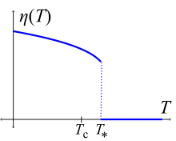
One of two Landau approaches for 1’st order transitions
This approach looks very similar to the virial equation of state of Onnes
ΔF = A(T) Γ ² – B₀ Γ ⁴ + C₀ Γ ⁶
First term negative above T₀, second term negative, third term positive
A(T) = A₀ (T - T₀); T₀ is a temperature where A(T) changes sign (not T_{c})
A₀, B₀, C₀ are positive and constant
T > T* (and T > T₀ ), ΔF(Γ) increases for all Γ so minimum is at Γ₀ = 0
T < T* , ΔF(Γ) decreases in Γ from Γ =0 to a minimum at ± Γ ₀(T) with ΔF < 0
T₀ <T< T*, ΔF(T) decreases then discontinuously drops to 0 at T*
To find T*
ΔF = 0
0 = A(T) Γ ² – B₀ Γ ⁴ + C₀ Γ ⁶ so, A(T) = B₀ Γ ² - C₀ Γ ⁴
2) dΔF/dΓ = 0
0 = 2A(T) Γ – 4B₀ Γ ³ + 6C₀ Γ ⁵ so, A(T) = 2B₀ Γ ² - 3C₀ Γ ⁴
or, B₀ - C₀ Γ ² = 2B₀ - 3C₀ Γ ²
Γ ²(T*) = B₀/2C₀
3) From 1) A(T) = B₀ Γ ² - C₀ Γ ⁴
And A(T*) = B₀ (B₀/2C₀) - C₀ (B₀/2C₀)² = B₀²/4C₀
A(T*) = A₀ (T* - T₀) so, T* = T₀ + B₀²/(4 A₀ C₀)
Landau invented the terms first and second order transition from this model.
1’st Order Transition shows a discontinuity in Γ₀(T)
Γ₀(T)
T₀
Γ₀(T)
2’nd Order Transition doesn’t

Slide 27






At the Curie transition (second order transition)
Γ
Order parameter is 1 at 0 K so
and

Slide 28
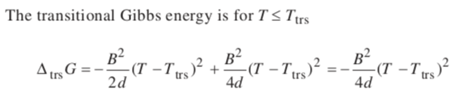
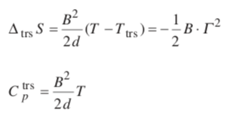

Slide 29

Single Component Phase Diagrams
For a single component, an equation of state relates the variables of the system, PVT
PV = RT or Z = 1 Ideal Gas at low p or high T or low ρ
Virial Equation of State
So, a phase diagram for a single component will involve two free variables, such as P vs T or T versus ρ.
Other unusual variables might also be involved such as magnetic field, electric field. Then a 2D phase diagram would require specification of the fixed free variables.
Z is the Compressibility Factor
B is the second order virial coefficient which reflects binary interactions, ρ²
B has units of volume and is related to the excluded volume (will see later with VDW EOS)

Slide 30
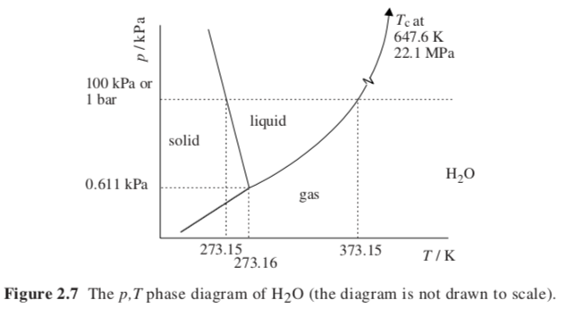
Single Component Phase Diagrams
Isochoric phase diagram
Fill a piston with the material at p and T, and observe the pressure as the temperature is varied holding the volume constant
For a single component, an equation of state relates the variables of the system, PVT

Slide 31
Isothermal
Isochoric
http://ecoursesonline.iasri.res.in/mod/page/view.php?id=2406

Slide 32
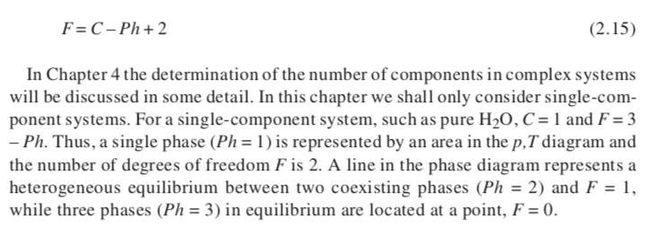
Gibbs Phase Rule
Number of DOF = Components – Phases + 2
More components more freedom
More phases more constraints
F = 2 area; F = 1 line; F = 0 point on a 2d phase diagram

Slide 33
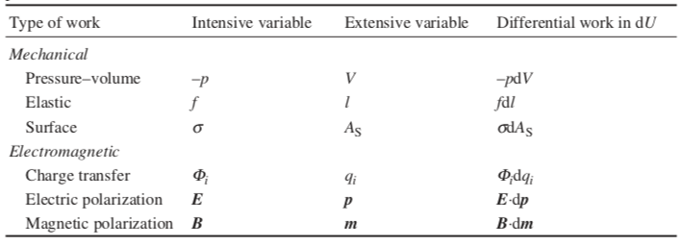
Field Induced Transitions

Slide 34
Consider constant volume (isochoric) and subject to a magnetic field
-S U V
H A
-p G T
Assume constant volume, V
dU = -pdV + TdS + Bdm = TdS + Bdm
dA = -SdT – pdV +Bdm = -SdT + Bdm
Magnetic Field Strength B (intrinsic)
Magnetic Moment, m (extrinsic)
(strength of a magnet)
Magnetic moment drops with T
Torque = m x B
Legendre Transformation (isochoric dV = 0)
dA = -SdT + Bdm
So, A is naturally broken into functions of T and m
(dA/dT)_{m} = -S
(dA/dm)_{T} = B
dA = (dA/dT)_{m} dT + (dA/dm)_{T} dm
Take the second derivative
d²A/(dTdm) =((d/dT)(dA/dm)_{T})_{m} = ((d/dm)(dA/dT) _{m}) _{T} = d²A/(dmdT)
Using the above expressions and the middle two terms
(dB/dT)_{m,V} = -(dS/dm)_{T,V}
This is a Maxwell Relationship, and the process is called a Legendre transformation

Slide 35
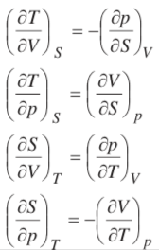
Consider constant volume (isochoric) and subject to a magnetic field
-S U V
H A
-p G T
Assume constant volume, V
dU = -pdV + TdS + Bdm = TdS + Bdm
dA = -SdT – pdV +Bdm = -SdT + Bdm
Magnetic Field Strength B
Magnetic Moment, m
(strength of a magnet)
Magnetic moment drops with T
Torque = m x B
Legendre Transformation
We want to know how the magnetic moment, m, changes with temperature at constant volume and field strength, B, (dm/dT)_{B,V}. Intuitively, we know that this decreases.
Define a Helmholtz free energy (HFE) minus the magnetic field energy, A’,
A’ = A – Bm and set its derivative to 0. This is the complete HFE for a magnetic field, (see the Alberty paper section 4, probably need to read the whole paper or just believe it)
dA’ = 0 = dA – Bdm – mdB = -SdT + Bdm –Bdm –mdB = -SdT –mdB = 0
We can perform a Legendre Transform on this equation yielding:
(dm/dT)_{B,V} = (dS/dB)_{T,V}
So, the change in magnetic moment with temperature (which decreases) is equal to the reduction in entropy with magnetic field (as the material orders).
With this extension the four Maxwell relations expand to 27 with the normal parameters and a very large number if you include the different fields in slide 16

Slide 36
Magnetic field strength decreases with temperature
The Curie temperature is where magnets lose their permanent magnetic field
(dm/dT)_{B,V} = (dS/dB)_{T,V}
The rate of change of magnetic moment in temperature at constant field reflects the isothermal change in entropy with magnetic field. At the Curie Temperature entropy doesn’t change with field at constant temperature.
Ising Model

Slide 37
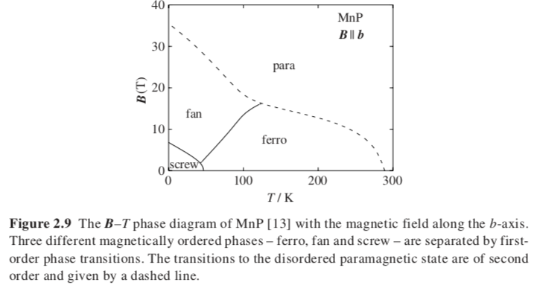
Gibbs Phase Rule with n additional components
Degrees of freedom, F plus number of phases Ph, equals the number of components, C ,plus 2 plus the number of additional components considered, n.

Slide 38
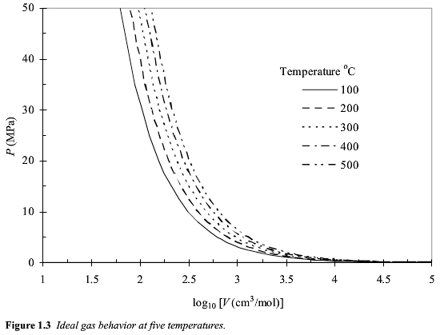
Equations of State for Gasses
Ideal Gas: pV = RT p = ρRt Z = 1
P ~ 1/V

Slide 39

Chemical Potential of an Ideal Gas
-S U V
H A
-p G T
dG = -SdT + VdP
At constant T
(dG = Vdp)_{T}
For an ideal gas V = RT/p
ΔG = RTln(p_{f}/p_{i}) Ideal Gas at constant T, no Enthalpic Interactions
For single component molar G = μ
μ₀ is at p = 1 bar
μ = μ₀ + RT ln p

Slide 40
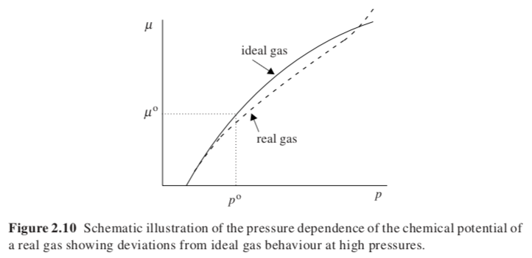

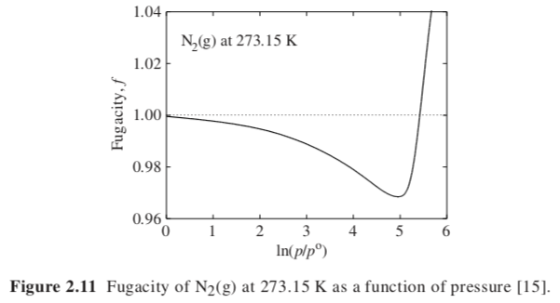
Real Gas
μ = μ₀ + RT ln p i.g.
At equilibrium between two phases the chemical
potentials are equal and the fugacities of the two phases are also equal.

Slide 41









Z = 1
P= RT/V
Ideal Gas Equation of State
Van der Waals Equation of State
Cubic Equation of State
P = RTρ/(1-bρ) – a ρ²
Law of corresponding states
Virial Equation of State of Onnes
Peng-Robinson Equation of State (PREOS)
Cubic Equation of State
Solve cubic equations (3 roots)

Slide 42
Single Component Phase Diagrams
Isochoric phase diagram
For a single component, an equation of state relates the variables of the system, PVT

Slide 43
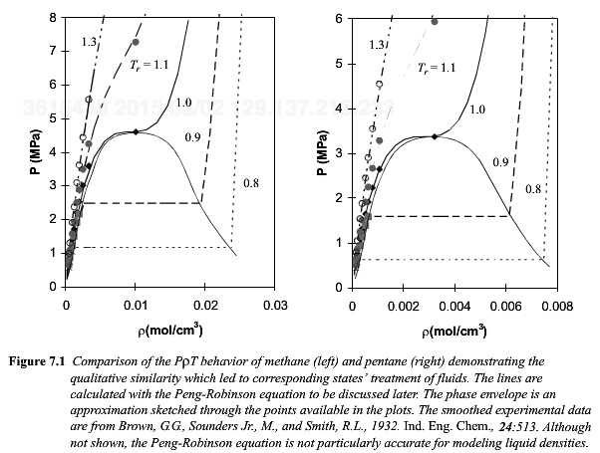
Compound | Tc(K) | Pc(MPa)
METHANE | 190.6 | 4.604
ρ_{c} = 0.0104 mol/cm³
Gas | T_{c} (K) | P_{c} (MPa)
ISOPENTANE | 460.4 | 3.381
ρ_{c} = 0.00287 mol/cm³
At 0.8 * 460.4K = 368K
And 0.64 MPa 2 phases
Higher pressure liquid
Lower vapor

Slide 44
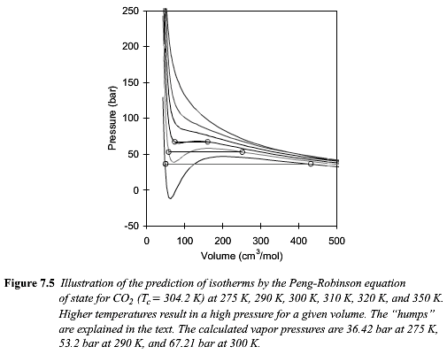

Slide 45
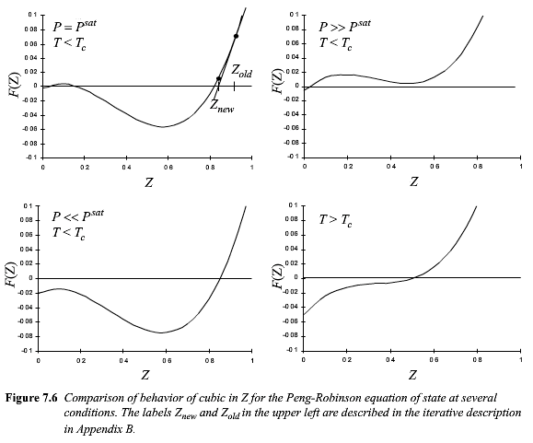
F(Z)=

Slide 46
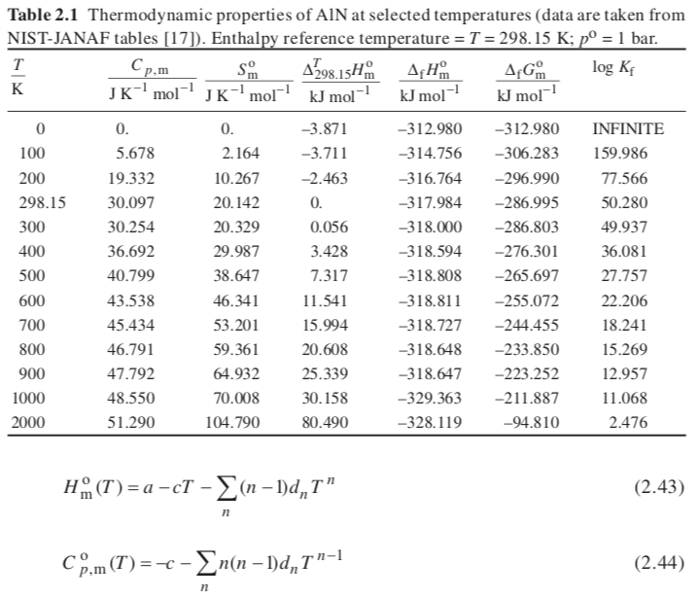

-S U V
H A
-p G T
CALculation of PHAse Diagrams, CALPHAD
For metal alloys to construct phase diagrams
Calculate the Gibbs Free Energy
Use a Taylor Series in Temperature
Determine the phase equilibria using the chemical potentials
Calculate the derivatives of the free energy expression
Get H_{m}^{SER} from H_{m}⁰ for the components

Slide 47
